Slide 1
18PYB103J
SEMICONDUCTOR PHYSICS
UNIT 5
Introduction to Low dimensional systems
Quantum Well,Wire ,Dot
Lecture 2,3

Slide 2
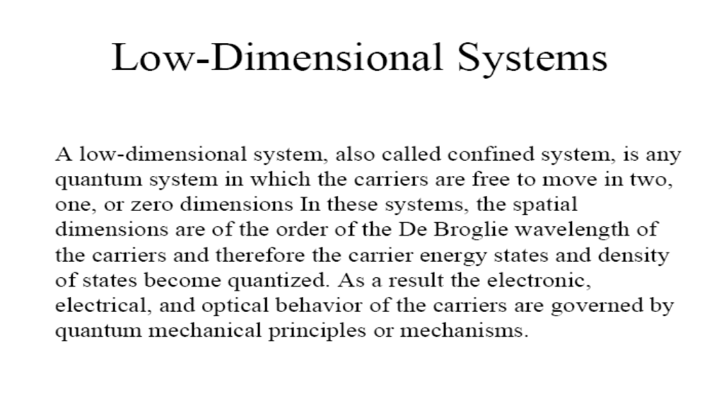
Electrical Measurements:
Measurements of electrical quantities, such as voltage, impedance, current, AC frequency and phase, power, electric energy, electric charge, inductance, and capacitance
Electrical measurements are among the most widely performed types of measurement.
The resistivity measurements can be studied by different techniques

Slide 3
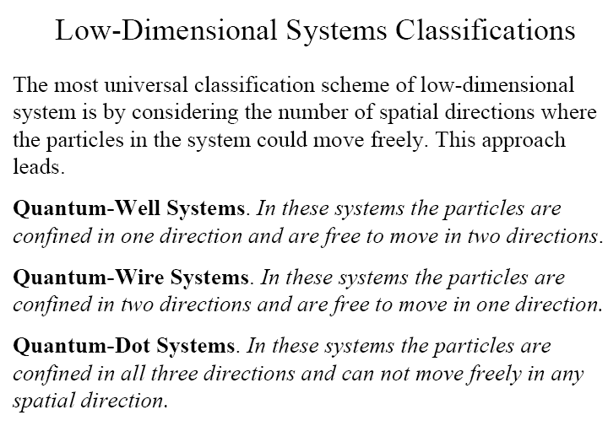

Slide 4
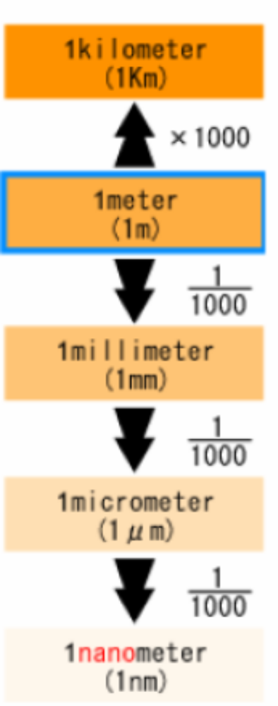
SIZE
A meter is about the distance from the tip of your nose to the end of your hand (1 meter = 3.28 feet).
Millimeter- One thousandth of meter.(10⁻³m)
Micron: a micron is a millionth of a meter (or) one thousandth of millimeter (10⁻⁶m)
Nanometer:
A nanometer is one thousandth of a micron (10^{–9}m)
(or) a billionth of a meter. ie.,one billion nanometers in a meter.

Slide 5
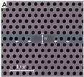
BASIC CONCEPTS OF NANOSCIENCE AND NANOTECHNOLOGY
QUANTUM WIRE, QUANTUM WELL AND
QUANTUM DOT

Slide 6
Nanotechnology comprises the emerging application of Nanoscience.
It’s dealing with functional systems either based on the use of sub-units with specific size-dependent properties or of individual or combined functionalized sub-units.
A branch of science and engineering devoted to the design and production of extremely small electronic devices and circuits built from individual atoms and molecules.
It’s a technology dealing with matter on a molecular size scale of nanometers
Nanotechnology also defined as use of technology to create materials on an atomic scale.
Notes:
UNIT IV Nanomaterials & Nanotechnlogy

Slide 7
Producing materials and devices that take advantage of physical, chemical and biological principles whose causes are found in the nanometre scale.
A nanometre (nm) is one billionth of a metre.
For comparison purposes, the width of an average hair is 100,000 nm.
Human blood cells are 2,000 to 5,000 nm long, a strand of DNA has a diameter of 2.5 nm, and a line of ten hydrogen atoms is one nm.
Nanotechnology is distinguished by its interdisciplinary nature.
For one thing, investigations at the nanolevel are occurring in a
variety of academic fields. These areas includes, Physics,
Chemistry, Biology etc……….
Notes:
UNIT IV Nanomaterials & Nanotechnlogy

Slide 8
Physics : The construction of specific molecules is governed by the physical forces between the individual atoms composing them.
Nanotechnology will involve the continued design of novel molecules for specific purposes.
Researchers need to understand how quantum physics affects the behavior of matter below a certain scale.
Chemistry : The interaction of different molecules is governed by chemical forces.
Nanotechnology will involve the controlled interaction of different molecules, often in solution.
Understanding how different materials interact with each other is a crucial part of designing new nanomaterials to achieve a given purpose.
Notes:
UNIT IV Nanomaterials & Nanotechnlogy

Slide 9
Biology : A major focus of nanotechnology is the creation of small devices capable of processing information and performing tasks on the nanoscale.
The process by which information encoded in DNA is used to build proteins, which then go on to perform complex tasks including the building of more complex structures, offers one possible template.
Computer Science : Moore’s Law and its corollaries, the phenomena whereby the price performance, speed, and capacity of almost every component of the computer.
In communications industry has improved exponentially over the last several decades, has been accompanied by steady miniaturization.
UNIT IV Nanomaterials & Nanotechnology
Notes:
UNIT IV Nanomaterials & Nanotechnlogy

Slide 10
Electrical Engineering : To operate independently, nanodevices will need a steady supply of power.
Moving power into and out of devices at that scale represents a unique challenge.
Within the field of information technology, control of electric signals is also vital to transistor switches and memory storage.
A great deal of research is also going into developing nanotechnologies that can generate and manage power more efficiently.
Mechanical Engineering :Even at the nanolevel issues such as load bearing, wear, material fatigue, and lubrication still apply.
Detailed knowledge of how to actually build devices that do what we want them to do with an acceptable level of confidence will be a critical component of future research.
Notes:
UNIT IV Nanomaterials & Nanotechnlogy

Slide 11
Nanomaterials
Nanomaterials or nanophase materials are the materials which are made of grains that are about 100nm in diameter and contain less than few ten thousands of atoms.
The grain sizes of the conventional materials vary from few microns to few millimeters and contain several billions of atoms.
Notes:
UNIT IV Nanomaterials & Nanotechnlogy

Slide 12
  Quantum well, Quantum wire and Quantum dots
When the size or dimension of a material is continuously reduced from a large or macroscopic size, such a metre or centimetre, to a very small size, the properties remain the same at first, then small changes begin to occur, until finally when the size drops below100 nm, dramatic changes in properties can occur.
If one dimension is reduced to the nanorange while the other dimensions remain large, them we obtain a structure known as quantum well.
If two dimensions are so reduced and one remains large, the resulting structure is referred to as a quantum wire.
The extreme case of this process of size reduction in which all three dimensions reach the low nanometer range is called a quantum dot.
Notes:
UNIT IV Nanomaterials & Nanotechnlogy

Slide 13
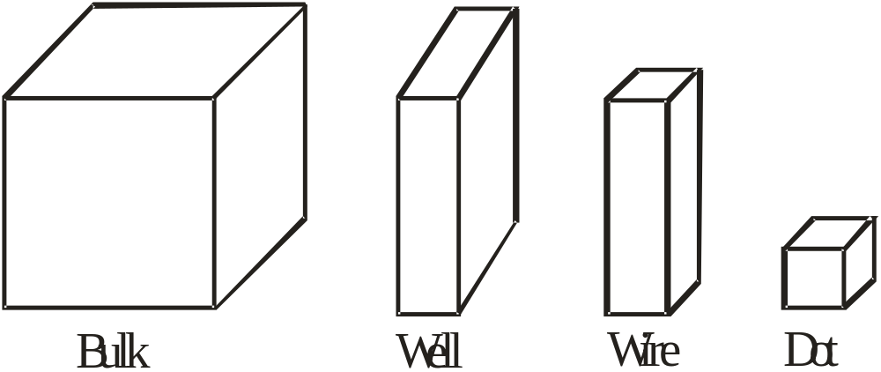
Progressive generation of rectangular nanostructures.
Notes:
UNIT IV Nanomaterials & Nanotechnlogy

Slide 14
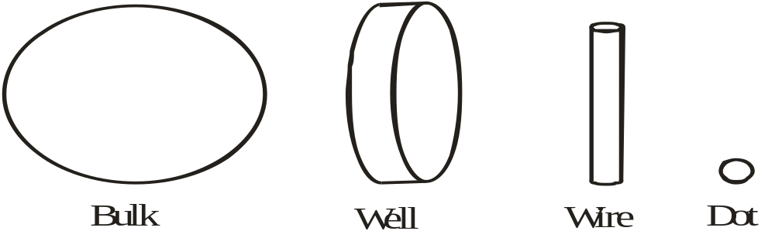
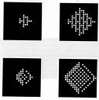
Progressive generation of curvilinear nanostructures.
Notes:
UNIT IV Nanomaterials & Nanotechnlogy

Slide 15
The word quantum is associated with the above three types of nanostructures because the changes in properties arise from the quantum mechanical nature of physics in the domain of the ultra small.
The above fig. represents the processes of diminishing the size for the case of rectilinear geometry and the corresponding reductions in curvilinear geometry.
The conduction electrons are confined in a narrow dimension and such a configuration is referred as quantum well.
A quantum wire is a structure such as a copper wire that is long in one dimension, but has a nanometer size as its diameter. In this case, the electrons move freely along the wire but are confined in the transverse directions.
The quantum dot may have the shape of a tiny cube, a short cylinder or a sphere with low nanometre dimensions.
Notes:
UNIT IV Nanomaterials & Nanotechnlogy

Slide 16
One approach to the preparation of a nanostructure, called the bottom – up approach, is to collect, consolidate and fashion individual atoms and molecules into the structure.
This is carried out by a sequence of chemical reactions controlled by series of catalysts.
It is a process that is widespread in biology where, for example, catalysts called enzymes assemble amino acids to construct living tissue that forms and supports the organs of the body.
The opposite approach to the preparation of nanostructures is called the top – down method, which starts with a large – scale object or pattern and gradually reduces its dimension or dimensions.
This can be accomplished by a technique called lithography which shines radiation through a template on to a surface coated with a radiation – sensitive resist; the resist is then removed and the surface is chemically treated to produce the nanostructure.
Notes:
UNIT IV Nanomaterials & Nanotechnlogy

Slide 17
The semiconductors like PbS, GaAs, CdS etc., can be synthesized in the nanometer level and they are called as semiconductor quantum dots. Their properties like band gap, luminescence etc., always differs from their bulk counterpart.
The quantum structures are useful in the fabrication of high efficiency solar cells, infrared detectors, quantum dot lasers etc.
Properties of Nanomaterials
Unique properties
They have very high magneto resistance
They have lower melting point, high solid state phase transition pressure, lower Debye temperature and high self diffusion coefficient
They have high catalytic activity and lower ferroelectric
phase transition temperature
Notes:
UNIT IV Nanomaterials & Nanotechnlogy

Slide 18
Variation of physical properties with size
It is well established that mechanical, electrical, optical, chemical, semi conducting and magnetic properties of a material depend strongly upon the size and the arrangement of the constituent clusters or grains.
(i) Electron affinities and chemical properties
Variation in electronic properties with size occurs only when there is a variation in inter particle spacing and geometry. As the size is reduced from the bulk, the electronic bands in metals become narrower and the delocalized electronic states are transformed to more localized molecular bonds.
Notes:
UNIT IV Nanomaterials & Nanotechnlogy

Slide 19
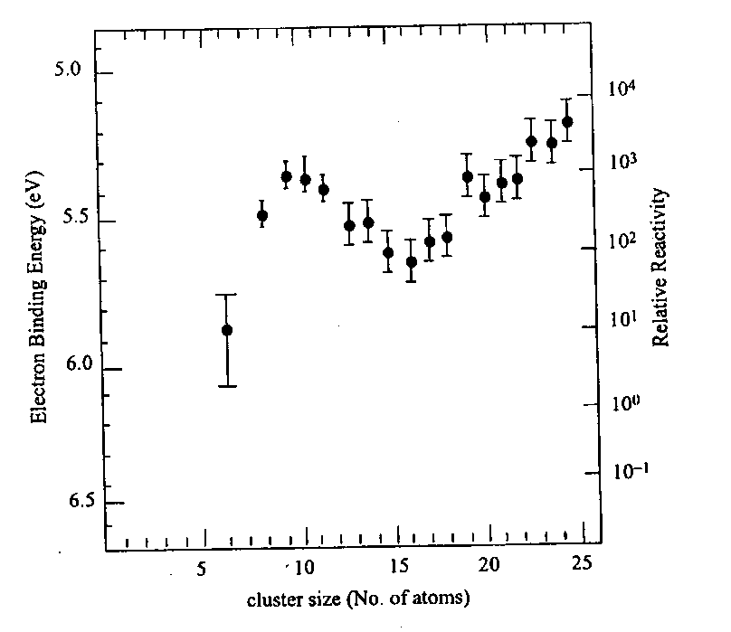
Variation in electronic properties with size occurs only when there is a variation in inter particle spacing and geometry.
As the size is reduced from the bulk, the electronic bands in metals become narrower and the delocalized electronic states are transformed to more localized molecular bonds.
Fig shows the ionization potential and reactivity of Fen clusters as a function of size.
The ionization potential are higher at smaller sizes than at the bulk work function .
The large surface – to – volume ratio and the variation in geometry and electronic structure have a strong effect on catalysis properties.
Ionization potential and reactivity of Fen clusters as a function of size
Notes:
UNIT IV Nanomaterials & Nanotechnlogy

Slide 20
(ii) Magnetic properties
Nano particles of magnetic and even non magnetic solids exhibit a totally new class of magnetic properties.
Table gives an account of magnetic behavior of very small particles of various metals.
Ferro magnetic and anti ferromagnetic multilayers have been found to exhibit Giant Magneto Resistance (GMR).
Small particles differ from the bulk in that these atoms will have lower
co-ordination number.
From the Fig, it is inferred that the small particles are more
magnetic than the bulk material
Metal | Bulk | Cluster
Na, K | Paramagnetic | Ferromagnetic
Fe, Co, Ni | Ferro magnetic | Super paramagnetic
Gd, Tb | Ferromagnetic | Super paramagnetic
Rh | Paramagnetic | Ferromagnetic
Table Magnetism in bulk and in nano particles
Notes:
UNIT IV Nanomaterials & Nanotechnlogy

Slide 21
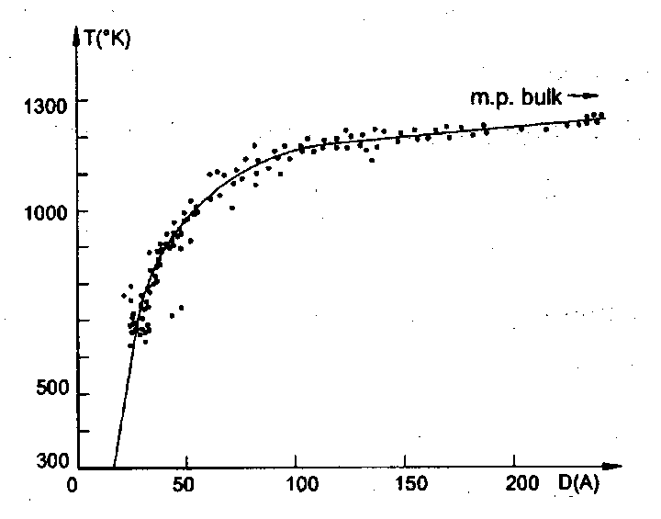
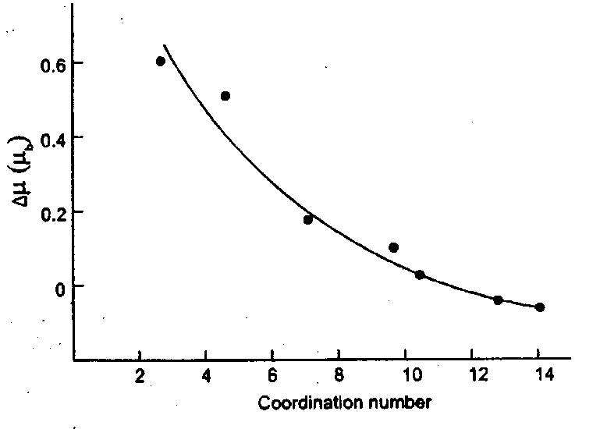
Change in bulk magnetic moment versus co- ordination number
Melting point of gold as a function of
grain size
(iii) Mechanical behaviour
From the Fig. it is evident that the melting point reduction is not really significant until the particle size is less than about 10nm.

Slide 22
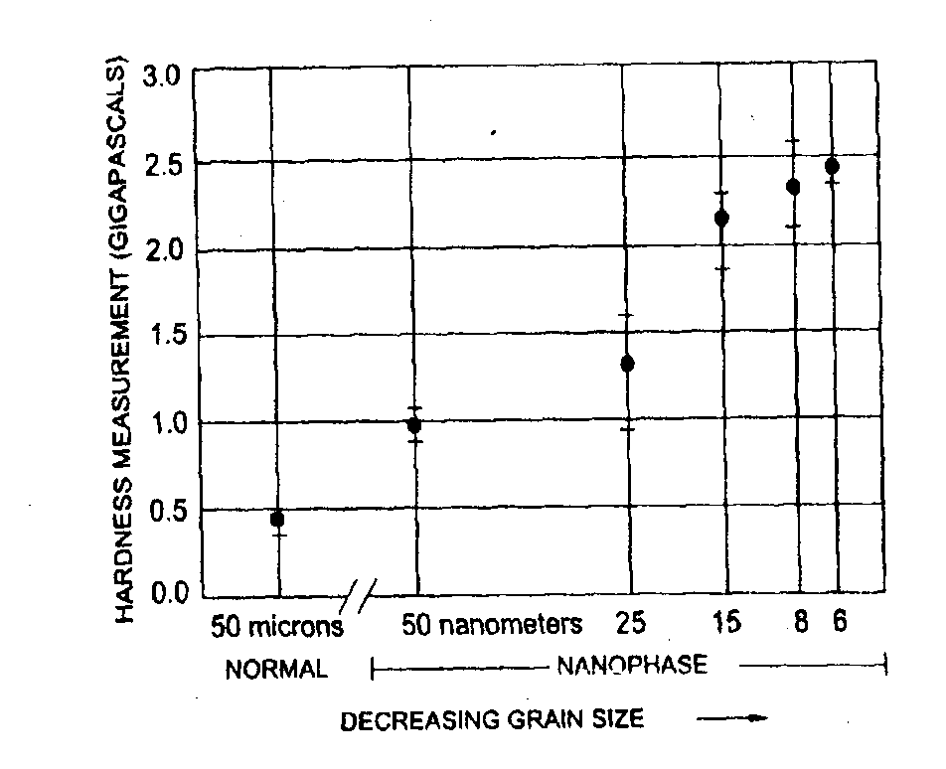
Nanophase metals with their exceptionally small grain size are found to be exceptionally strong.
It is because clusters and grains in nanophase material are mostly free from dislocations.
The variation of hardness with diameter of copper nano crystals is shown in Fig.
From the Fig. it is revealed that when the grains size was 50nm in diameter, the copper was twice as hard as usual.
Thus the material in nano phase has very high strength and super hardness.
Fig. Strength of nanophase copper as a function of grain size

Slide 23
The basic principles of nanotechnology is positional control.
At the macroscopic scale, it is easy to hold parts in our hands and assemble them by properly positioning them with respect to each other.
At the molecular scale, the idea of holding and positioning molecules is new and almost shocking.
It is possible to continue the revolution in computer hardware right down to molecular gates and wires -- something that today's lithographic methods (used to make computer chips) could never hope to do.
One can inexpensively make very strong and very light materials: shatterproof diamond in precisely the shapes we want, by the ton, and over fifty times lighter than steel of the same strength.
It is possible to make surgical instruments with high precision and deftness that one could operate on the cells and even molecules from which we are made - something well beyond today's medical technology
Nanotechnology makes almost every manufactured product faster, lighter, stronger, smarter, safer and cleaner.

